Slide 1
Corporate Stress Testing (CST)
CST Processing flow overview
CST Support
October 17, 2008
Strictly Private and Confidential

Slide 2



Corporate Stress Testing Overview
Stress Loss Calculation is done by data providers
Stress packages
> Board Of Directors
> Regional, Consumer, Consolidated
Data Sources
Data Providers
Stress Test Team
> GMR
ICG Trading
Upload Stress Test Results
> From excel file, flat file
> Copy data from other periods
> Modify data copy rules
> Send/Receive iVAST data
Generate Stress Reports
> Run batch reports
> Review and adjust stress reports
> Prepare final stress reports
Analysis
> Consolidated stress data
> Granular data from providers
> Data dump
> NOVA
> GRR
> MCC
> PSE
CVA Trading
FX Unhedged
non-USD
Book Capital
> MANUAL
CST Application
> STORM
> CALYPSO
> OASYS
Retail Macro
Hedges
CST GUI (via CitiRisk Portal)
Retail Credit
Data Maintenance
Process Monitoring
Reports
Analysis
> GCBC
> Data upload utility
> Data copy utility
> Data copy rules
> Risk type substitution rules
> Hierarchy maintenance
> Data upload process
> Batch report process
> iVAST feed process
> Data dump reports
> Single reports
> Batch reports
> Consolidated data
analysis
> Raw feed data
analysis
> GRR
> GCBC
Wholesale
Credit
> ARTEMIS
> CALM
ALM
> FIGARO
CAI
ETL (AbInitio)
Java Services
Cognos Reports / Cube
> MANUAL
Pension Risk
CST Database
> Assumptions
> Spread Shocks
> Market Levels
> Curve Shifts
> Citi holdings Template
Instructions for
iVAST feed to & from GMR
monthly stress
> Scenario definitions
> Business Unit Hierarchy
> Consolidated Stress Data
> Granular data from feeds
> Rules/Configuration info …
testing

Slide 3
CST – Data Mart
Oracle 10g
CST Database
Raw Feed
Tables
Consolidated
Tables
Hierarchy
Tables
Dimension
Tables
Audit
Tables
Lookup
Tables
Summary
Tables
Configuration Tables

Slide 4
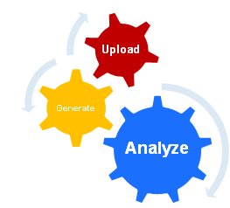
CST – Feed Processing
Validation
(Ab initio 3.0)
Feed Processing
(Ab Initio 3.0)
Users Upload Files
24/7
Initiate
History processing
Validation & Summary Emails
1
1
2
Control of when to initiate feed
Autosys Polling Job
Process Feed
DB Maintenance Jobs
Consistent Report View
2
3
Rule based Data Copy
File Validation
Consolidate Scenario Numbers
Support of Legacy Excel Feeds
3
4
4
4
Capture Rejects/Errors/Warnings
Data Validation
5
6
Send Notification and wait Initiation
7
6
6
6
Load Prep
Summary
Load Prep
Raw Feeds
Load Prep
CST DM
8
9
Status & Summary Tables
Raw Feed Tables
CST – Live/Alt Tables
CST GUI (via CitiRisk Portal)

Slide 5
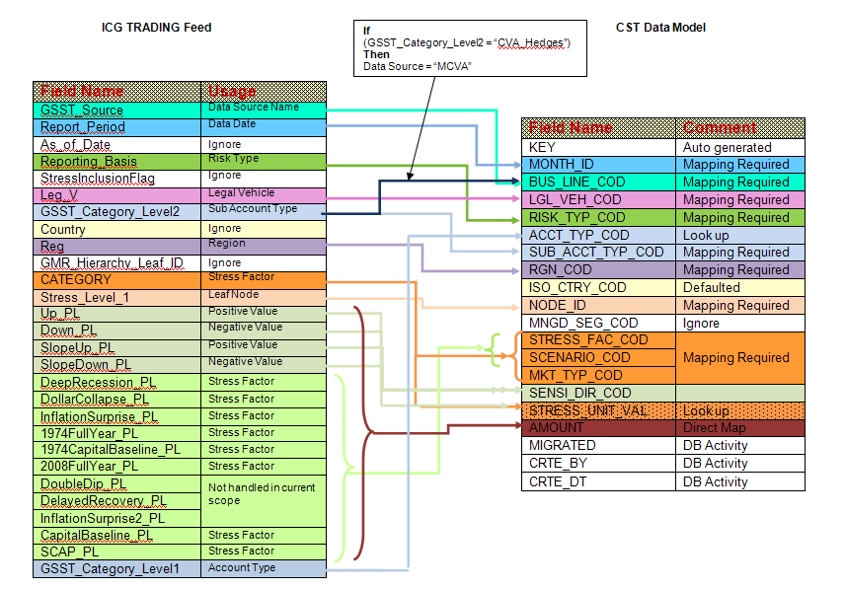
CST – Feed to Data Model Mapping

Slide 6
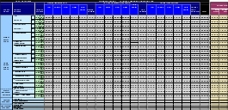




CST – Cognos Work Flow
Business Users
Business Users
Business Users
Canned Reports
Ad hoc Analysis
Develop and publish
The ad hoc analysis Reports
CitiRisk CST UI
CST Canned Reports
Consolidated ,Raw feed Analysis Layer
(Real Time & cube)
Cognos Server (STE)
Report Studio
Query Studio
Analysis Studio
Develop and Publish
Reports
Data Sources
Generate
Cognos Cubes using transformer
CST Database
Raw Feed
Tables
CST Consolidated
Tables
Hierarchy
Tables
Dimension
Tables

Slide 7
Report Studio
Powerful self-service exploration/discovery
Start with the big picture, then discover issues and identify trends
Quickly assess relative performance and make powerful comparisons
Follow line of thought with multiple flow-on questions
Reporting and analysis combined
Navigate by key business drivers
Drill up/down/through in any report/analysis
Consistent user experience and interface
Query Studio
Congos 8.4.1
(Framework Mgr,Transformer)
Users can do the ad hoc analysis both on Relational and dimensional data
Drag and drop, point and click user interface
Advanced calculation and formatting logic that is completely GUI driven with no coding
Designed for non technical business users
Users can be self sufficient; reduces IT backlog
Requires minimal training
Enhanced functionality means business users can create more powerful and formatted reports without involving IT
Single sign on with existing applications enhances end user experience
Reports off any data source including: OLAP, relational, flat file, XML
Content is published to the Web after dev. in client
Zero-footprint, browser-based environment requires no desktop installs, plug-ins, or applets
Enables remote access to the system; log on from anywhere from remote Web-based administration and report authoring
Point-and-click, task-based UI improves user adoption, increases self-service, and reduces dependence on IT
Cognos Query Studio
Cognos Analysis Studio
Event Studio
Report Studio
Users can do the ad hoc analysis only on dimensional data
Leverage Power Cubes or 3rd party OLAP sources
Supports dimensionally modeled RDBMS data
Leverage existing Power Cubes as a data source, with enhanced UI capabilities and features:
Nested top and bottom reports to isolate best/worst performers
Automated monitoring and management
Real time alerts within portal or email
Automatic launching of business processes
Integration with BPM applications (e.g. FileNet)
Bursting, scheduling
Event Studio
Analysis Studio

Slide 8

CST – User Interface
Citirisk Portal / ESAT
Browser / Flash Player
Reporting Features
Data Upload Features
Admin Features
BSST Features
Software Stack
Presentation Layer
Batch Reports
Ivast Reports
Variance Reports
Data upload
Copy to New Period
Hierarchy Maintenance
Automated Testing
Publish Batch Reports
Risk Type Override Rules
Stress Data Upload
BSST Ivast reports
Copy to New Period
Copy BSST to CST
O/S Framework
BlazeDS
Utilities
Apache POI
Hibernate
Jcraft JSCH
Spring
J2EE / Weblogic
Reporting Services
Upload Services
Admin Services
BSST Services
Cognos SDK
Java Mail API
Services Layer
Utility Services
Excel - Email - SFTP Utilities
Data Access Layer
CST Jobs
Batch
Job
Ivast
Job
CST Database
Polls
Monitor Job
Variance
Reports Job
Automated
Testing Job

Slide 9
CST – Job Workflow
CST User Interface
Step1. Send Request
Batch Report
Send Ivast
File Upload
Automated Testing Report
Step 4.1 If unusual delay in processing; send an alert email
CST Database
Step 4. Monitor requests
Monitor Job
Step2. Polls
Step 3. Update periodically the status of the request
Batch
Job
Ivast
Job
Variance
Reports Job
Automated
Testing Job
Step 5. Send notification email if success/failure
Feed Processor

